Slide 1




WELCOME
TO CHAMBERLAIN
Learn more about the BSN Online Option and meet our team

Slide 2

TRANSFORMING HEALTHCARE
ENVIRONMENT
PATIENTS
& FAMILIES
WE ARE CHAMBERLAIN
A COMMUNITY OF CARE
STUDENTS
FACULTY
& STAFF
SELF
Notes:
Chamberlain University has a strong culture centered on care. Chamberlain Care describes our unique culture that provides our students with a community of support (including support from admissions, student services, faculty and fellow students) as well as tools and resources to be successful – not only as a student (focusing on academic excellence) but also in preparing and empowering them to be successful as extraordinary healthcare professionals
Our Chamberlain Care Model is based on the following:
Care for Self - starting here allows us to give more to those around us
Care for Colleagues and Faculty – who will in turn Care for our Students
Our Students will then provide that same level of care for patients and this will transform
healthcare in our global communities.

Slide 3



MEET OUR ACADEMIC LEADERS
Janina C. Johnson, DNP, RN, CNE
Director, BSN Online Program
Delaney LaRosa, MSN, RN
Dean, Academic Affairs
Notes:
I am Dr. Janina C Johnson, Director of the BSN Online Program. Also, joining us today
is Delaney LaRosa, Dean of Academic Affairs.

Slide 4




MEET OUR ADMISSION & STUDENT SERVICES TEAM MEMBERS
Cayra Holmes
Executive Advisor
Paula Kochan
Senior Advisor
Patrick Ryan
Manager, Student Services
Erin Howard-Prak
Manager, Student Services
Notes:
I would also like to introduce you to other members of our team that
will help you along your way in your journey to becoming a BSN-Online nursing student.
Maggie McDonald – Sr. Student Support Advisor
Kate Sibrava – Sr. Student Support Advisor
Patrick Ryan – Manager, Student Services
Erin Howard-Prak – Manager, Student Services

Slide 5
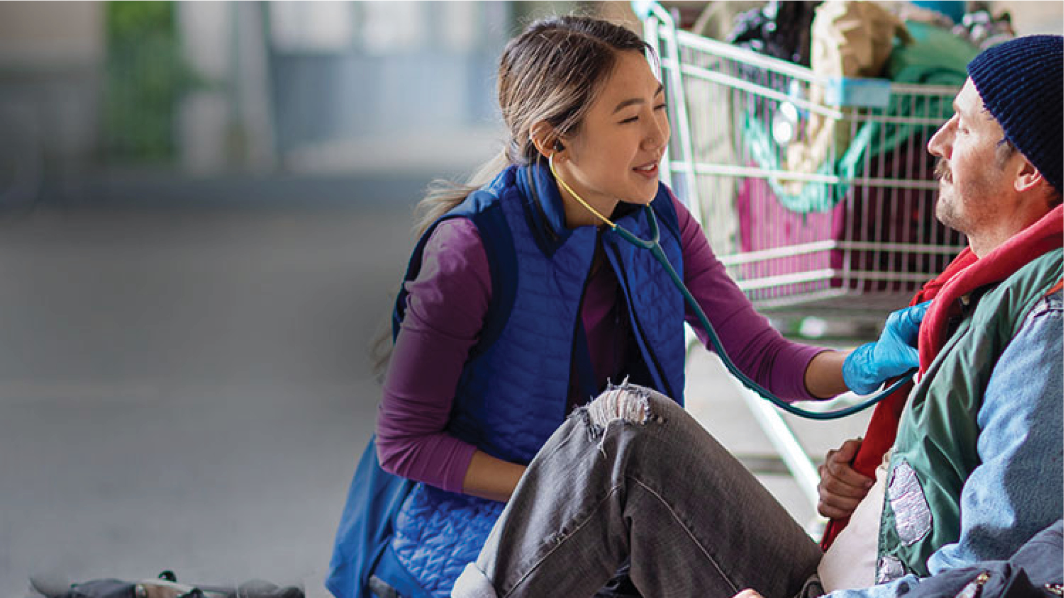
OUR VISION
By living Chamberlain Care®, we graduate extraordinary healthcare professionals who transform the health of people worldwide
OUR PURPOSE
To create an academic culture in which
colleagues and students thrive and that
cultivates extraordinary graduates
OUR MISSION
To educate, empower and embolden diverse healthcare professionals who advance the health of people, families, communities and nations
Notes:
Our Vision here at Chamberlain is that, by living Chamberlain Care®, we graduate extraordinary healthcare professionals who transform the health of people worldwide.
Chamberlain Care is culture, our value system, a commitment to our healthcare partners, patients, the community at large and, most importantly, to you, our students
We believe that if we take extraordinary care of our students, you will in turn take extraordinary
care of the patients and families you will serve
I will discuss Chamberlain Care in more detail a little later in this presentation, during your time
here on campus and throughout your admission and academic experiences here at Chamberlain
Our Mission is to educate, empower and embolden diverse healthcare professionals who advance
the health of people, families, communities and nations.
Our Purpose is to create an academic culture in which colleagues and students thrive and that cultivates extraordinary graduates.

Slide 6
TODAY WE ARE…
Designed for nurses,
BY NURSES
130-YEAR
history of
graduating nurses
One of the
LARGEST
nursing schools
in the country
20+
campuses
nationwide
ADDISON
CHICAGO
TINLEY
TROY
SACRAMENTO
INDIANAPOLIS
CLEVELAND
COLUMBUS
NORTH
BRUNSWICK
LAS VEGAS
ST. LOUIS
TYSONS CORNER
CHARLOTTE
PHOENIX
IRVING
ATLANTA
HOUSTON
NEW ORLEANS
SAN ANTONIO
JACKSONVILLE
PEARLAND
MIRAMAR
Notes:
Today, we have more than 20 campuses nationwide in 15 states.
With pre- and post-licensure programs, a growing network of campuses, and robust online offerings, Chamberlain University continues to raise the standard of nursing education and advance healthcare outcomes in communities across the country and around the world.
As a Chamberlain student, you are joining this national network of extraordinary students and alumni.

Slide 7
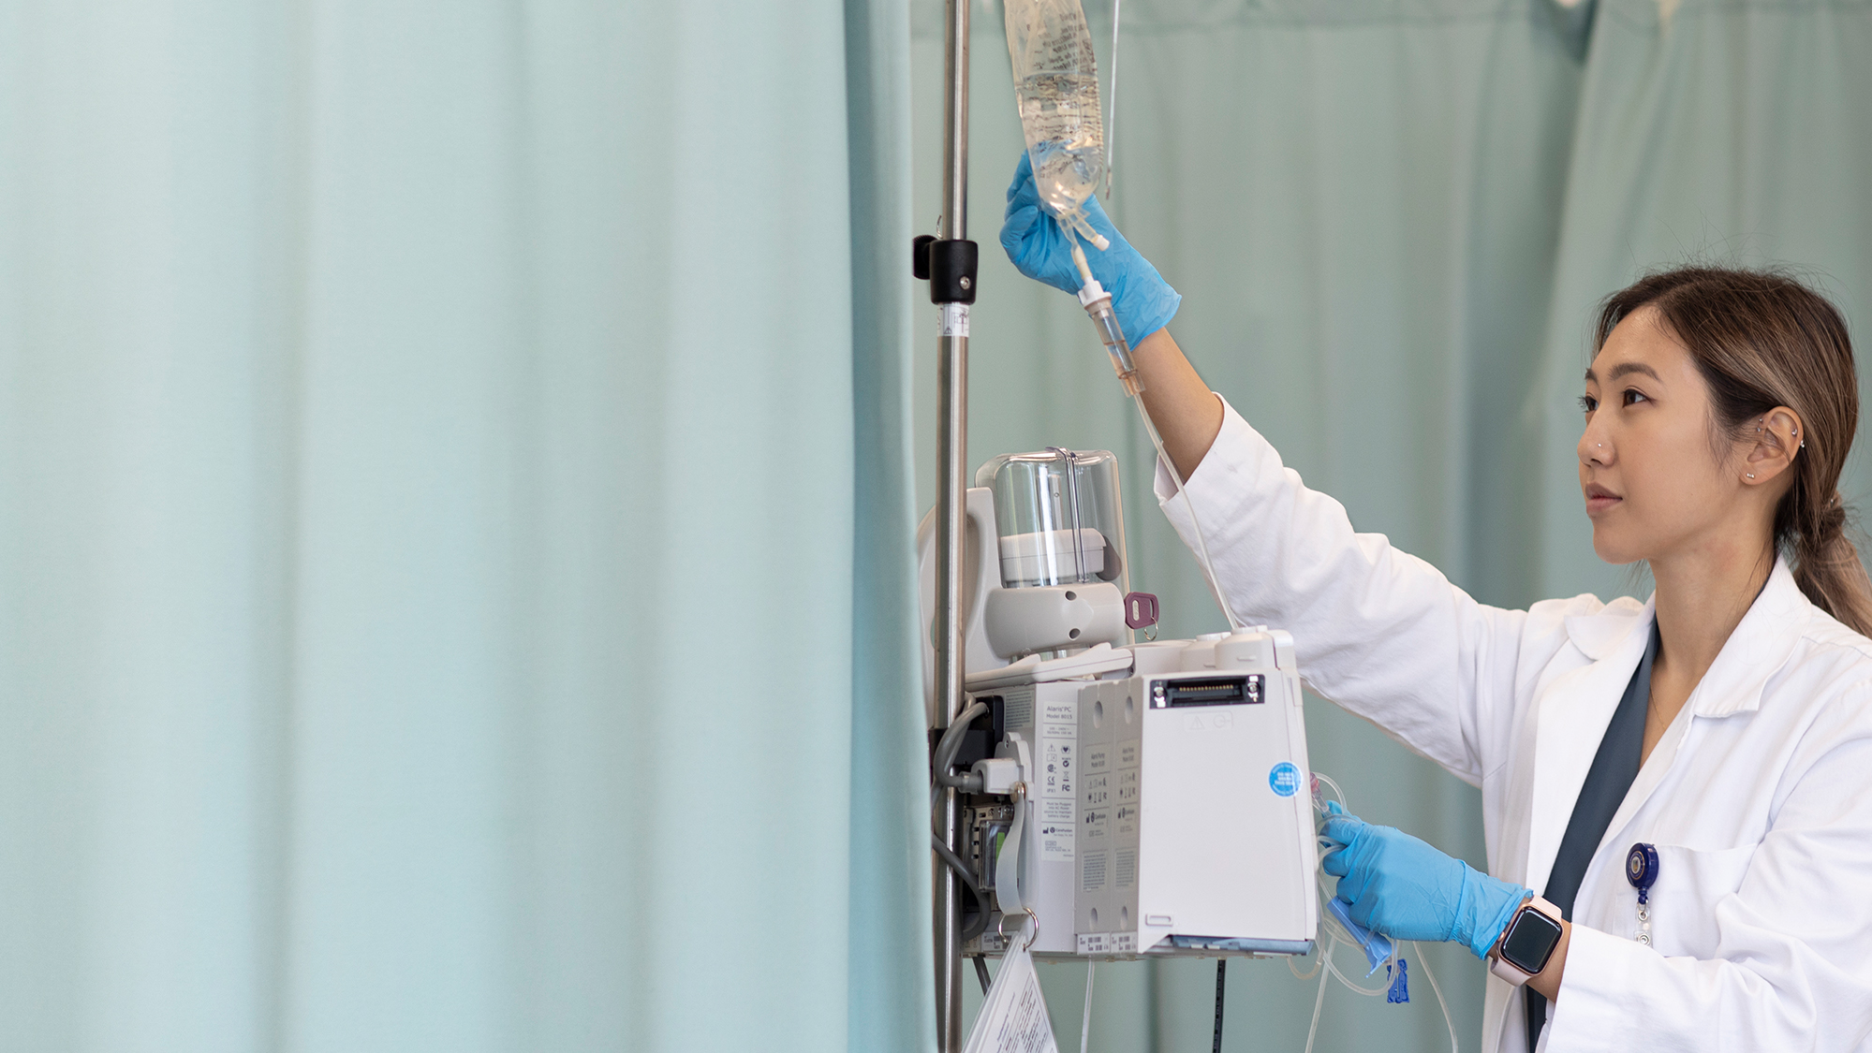
WHAT IS THE
BSN ONLINE OPTION?
Learn how you learn best with
Chamberlain’s personalized platform
Master real-life skills in a virtual way
with simulated patient encounters
Collaborate with your peers and nurse
educators through live interactions
Gain confidence through a live,
in-person skills practice and
check-off with faculty
Practice on-site with clinicals at
select healthcare partner sites
Notes:
The BSN Online Option is the newest option of Chamberlain’s Prelicensure BSN Program.
It is designed specifically for entry-level, pre-licensure students.
A Faster Path to Your Degree
In as few as 3 years of year-round study, you can have your BSN degree and be ready to work
in a clinical setting. Depending on your qualified transfer credits, you could even finish in less
than 3 years
Personalized, Adaptive Learning Platform Coupled with Experiential Learning
Benefit from an optimal blend of flexibility, interactivity and experiential learning led by experienced nurse educators. Your learning journey is customized with an adaptive platform and individualized plans that build on your strengths. You will participate in virtual simulations and labs
Dedicated Clinical Rotations: Prepare for real-world practice with professional care teams at a select partner healthcare system. You’ll have unique opportunities to help real people in real situations under the guidance of experienced nurses.

Slide 8


THE BEST OF
BOTH WORLDS
ONLINE CURRICLUM
& PREPARATION
+
ON-SITE PRACTICE
& MASTERY
Chamberlain's accredited BSN degree program adapted for
online delivery & practice readiness
Hands-on skills mastery
& clinical rotations at
Advocate Aurora Health,
a partner health system
Notes:
CU has an established footprint of campus-based pre-licensure nursing program. Building on this strong excellence of nursing education, Chamberlain is pleased to announce the BSN Online Degree Option. This option captures the best of both worlds: adapting Chamberlain’s curriculum for online delivery with dedicated, structured hands-on skills mastery and clinical experiences.
EMPHASIZE – developed or designed for online – thoughtful and intentional process to create
a pre-licensure BSN to be delivered in an online learning environment (not a reaction to current
shift from campus to virtual teaching due to COVID crisis)

Slide 9
OVERVIEW OF BSN DEGREE PROGRAM
Accelerated nursing program, designed to be completed in 3 years
Class format is online theory and virtual labs combined with on-site
clinical immersions at select partner locations
CHAMBERLAIN UNIVERSITY IS ACCREDITED BY
Chamberlain University is accredited by the Higher Learning Commission (www.hlcommission.org), a regional accreditation agency recognized by the U.S.
Department of Education. The baccalaureate degree in nursing program, master’s
degree in nursing program and Doctor of Nursing Practice program at Chamberlain
University are accredited by the Commission on Collegiate Nursing Education, 655
K Street NW, Suite 750, Washington DC 20001, 202.887.6791. For the most updated accreditation information, visit chamberlain.edu/accreditation.
Chamberlain University is approved to operate by the Virginia Board of Nursing Perimeter Center, 9960 Mayland Drive, Suite 300, Henrico, VA 23233-1463, 804.367.4515. Certified
to Operate by SCHEV. Unresolved complaints may be reported to the Illinois Board of Higher Education through the online complaint system http://complaints.ibhe.org/or by mail to
1 N. Old State Capitol Plaza, Suite 333, Springfield, IL 62701-1377.
For the most updated approvals by state information, visit chamberlain.edu/stateapprovals. Program/Program option availability varies by state/location. Chamberlain reserves the right
to update information as it becomes available.
HLC
(Higher Learning Commission)
The baccalaureate degree program in nursing, master’s degree program in nursing, Doctor of Nursing Practice program, and post graduate APRN certificate program at Chamberlain University
are accredited by
CCNE
(Commission on Collegiate Nursing Education)
Notes:
BSN online is an option of the campus-based prelicensure BSN program. As such it is also accredited by HLC, CCNE and approved for online delivery for residents of Wisconsin, Illinois, Minnesota, and Iowa who will attend onsite clinicals in Wisconsin.

Slide 10

BSN ONLINE
OPTION BENEFITS
Experienced faculty that
includes practicing nurses
and professional educators
A student-centric
learning environment with
individualized instruction
and personalized learning
Notes:
Chamberlain students benefit from a student-centric learning environment enhanced by small
class sizes, individualized instruction and diversified clinical learning opportunities
We are practicing nurses and professional educators
We offer:
Weekly outreach
Small class sizes
1:30 faculty-to-student classroom ratios
Diverse clinical learning experiences

Slide 11
BSN ONLINE
OPTION BENEFITS
Emphasis on engagement and collaboration through weekly
outreach to students
Small class sizes
1:30 faculty-to-student
average classroom ratios
Notes:
Chamberlain students benefit from a student-centric learning environment enhanced by small
class sizes, individualized instruction and diversified clinical learning opportunities
We are practicing nurses and professional educators
We offer:
Weekly outreach
Small class sizes
1:25 faculty-to-student classroom ratios
Addison – 30
Atlanta – 28
Columbus – 29
Diversified clinical learning experiences

Slide 12
BSN ONLINE
OPTION BENEFITS
Diversified clinical
learning experiences
1:8 faculty-to-student
average clinical ratios
Clinical partners include:
Advocate Aurora Healthcare
System – Wisconsin locations
Notes:
Chamberlain students benefit from a student-centric learning environment enhanced by small
class sizes, individualized instruction and diversified clinical learning opportunities
We are practicing nurses and professional educators
We offer:
Weekly outreach
Small class sizes
1:25 faculty-to-student classroom ratios
Addison – 30
Atlanta – 28
Columbus – 29
Diversified clinical learning experiences

Slide 13
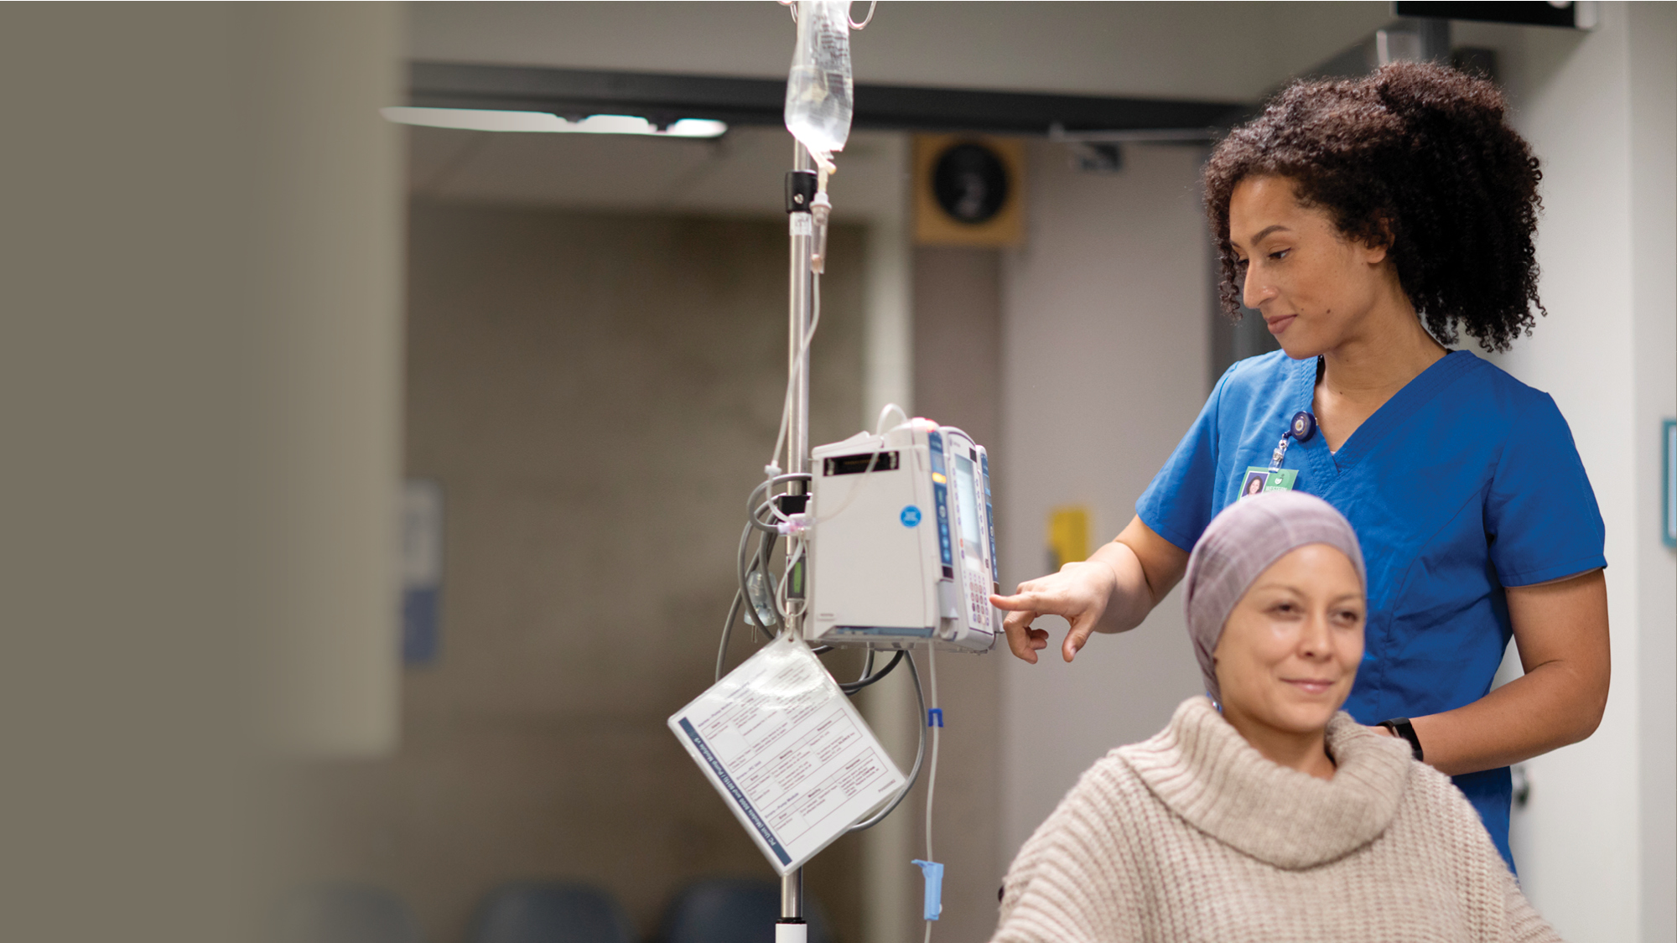
SUPPORT FOR
STUDENT SUCCESS
The right resources for your needs
One-on-one support every step
of the way for both academic
and non-academic needs
Customized workshops and small
virtual group study sessions
Opportunities to collaborate
with your peers and nurse educators through
live interactions
Notes:
Chamberlain students benefit from a student-centric learning environment enhanced by small
class sizes, individualized instruction and diversified clinical learning opportunities
We are practicing nurses and professional educators
We offer:
Weekly outreach
Small class sizes
1:30 faculty-to-student classroom ratios
Diverse clinical learning experiences

Slide 14
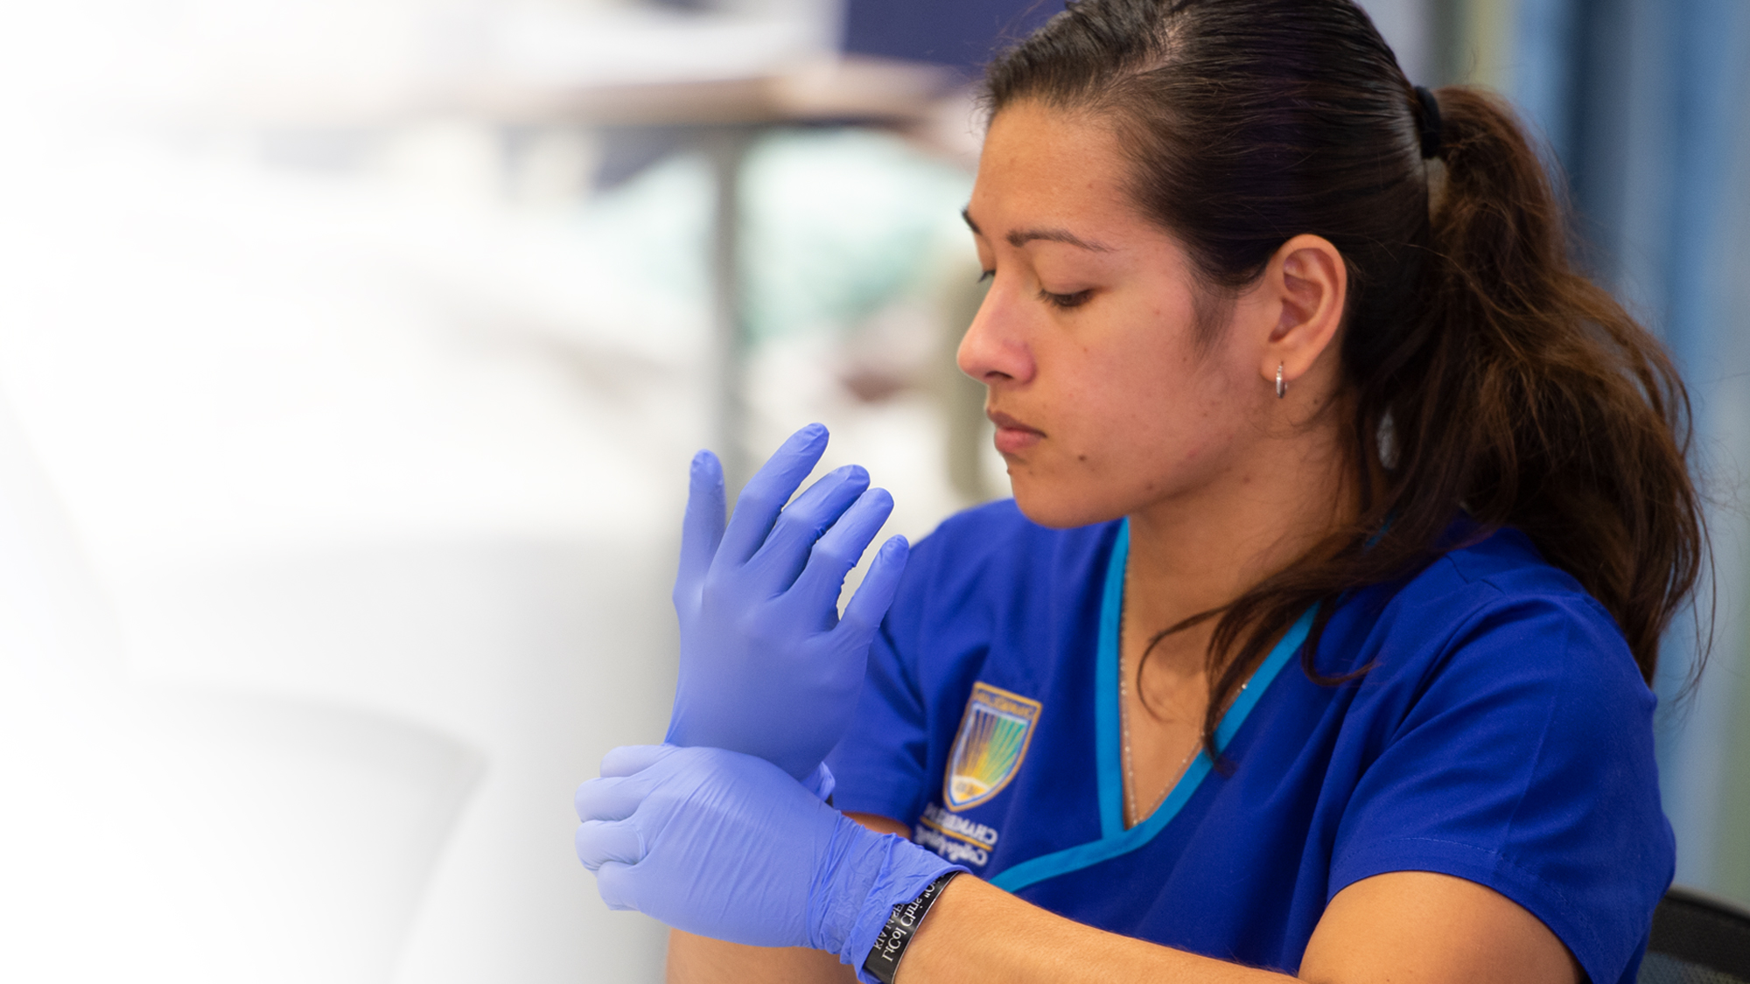
ACADEMIC RESOURCES
FOR STUDENTS
Experienced Student
Learning Specialists (RN)
and peer tutors
Tutoring appointments
are available and
strongly encouraged
Anatomy and physiology
models available
for study
Notes:
INSTRUCTIONS: Experienced Faculty
PRESENTER: (Recommended: Director of Admission or Faculty Chair)
SCRIPTING
We lay the foundation for NCLEX success in our Virtual Centers for Academic Success (CAS), through initial assessments, study skills reviews and test-taking workshops. Group sessions and one-on-one tutoring help students tackle academic challenges.
All VCAS services are complimentary
Resources include:
Nursing and general education support
Textbooks, models, manuals and more
Supplemental course materials developed by Chamberlain faculty, including sample test questions, worksheets
and study guides…

Slide 15
ACADEMIC RESOURCES
FOR STUDENTS
NCLEX® preparation support
At-home lab kits delivered
directly to you
Regular, one-on-one,
skills check-ins
The Virtual Center for
Academic Success (VCAS)
Notes:
INSTRUCTIONS: Experienced Faculty
PRESENTER: (Recommended: Director of Admission or Faculty Chair)
SCRIPTING
We lay the foundation for NCLEX success in our Virtual Centers for Academic Success (CAS), through initial assessments, study skills reviews and test-taking workshops. Group sessions and one-on-one tutoring help students tackle academic challenges.
All VCAS services are complimentary
Resources include:
Nursing and general education support
Textbooks, models, manuals and more
Supplemental course materials developed by Chamberlain faculty, including sample test questions, worksheets
and study guides…

Slide 16
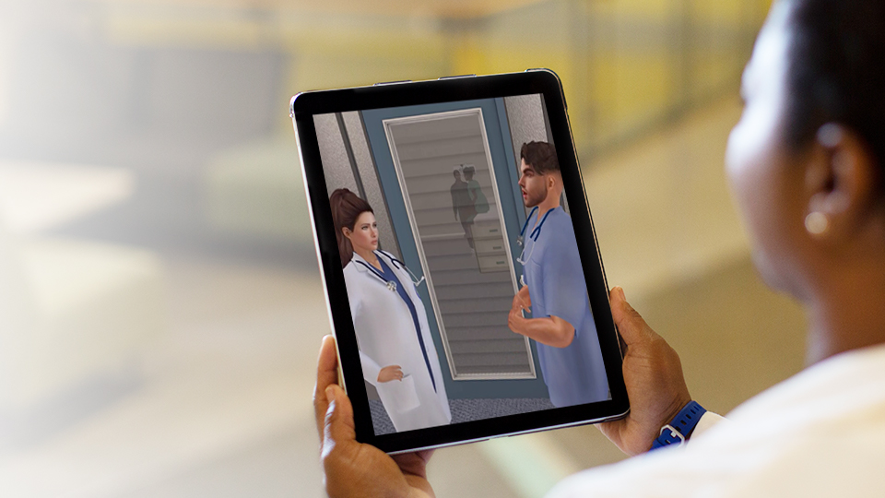
VIRTUAL
SIMULATION
12-220048 ©2022 Chamberlain University LLC. All rights reserved.
Notes:
INSTRUCTIONS: What Are We Going To Cover Today?
PRESENTER: (Recommended: Director of Admission)
SCRIPTING
Powered by i-Human Patients, the BSN Online Option curriculum includes next-generation
NCLEX® virtually simulated patient encounters to help students master each step of the clinical judgement task model.

Slide 17
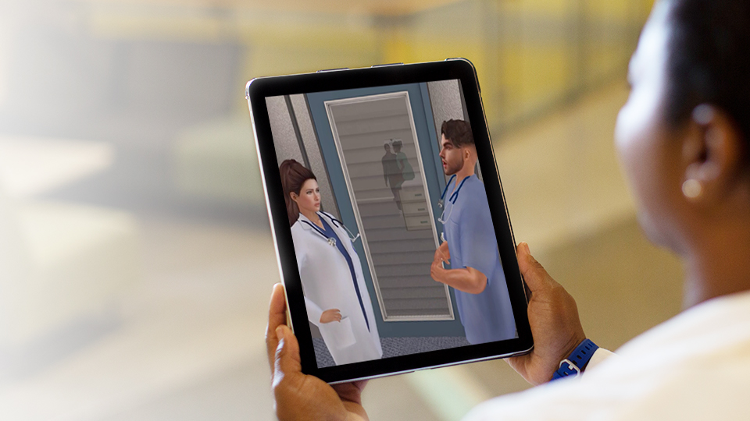
Active
Learning
Virtual
Nursing
Skills Labs
Virtual
Simulations
672
HOURS OF
EXPERIENTIAL
LEARNING
On-site
Retreat
Precepted
Clinical
Experiences*
On-site skills
review and
check offs
12-220048 ©2022 Chamberlain University LLC. All rights reserved.
Notes:
The BSN-OL option has the same required clinical hours as the campus-based program. Of the
672 hours, 25% will be conducted in virtual simualtion. The remaining 75% (508 hours) will occur
at clinical locations throughout the WI area.
Precepted clinical experiences are not available at all clinical locations.

Slide 18
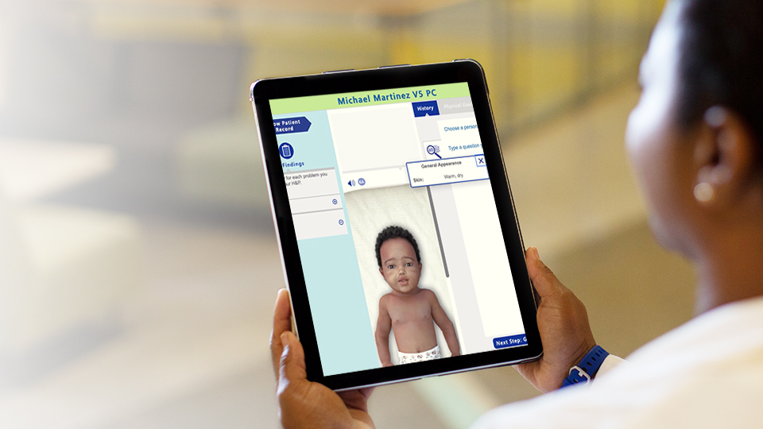
PRACTICE THROUGH ACTIVE LEARNING
Practice your
nursing skills in
a virtual learning environment.
Notes:
During your time in the program, we will give you opportunities to learn through living. We want
you to practice your skills before you ever touch your first patient. Students will have home lab kits
for practice, and virtually simulated lab skills. Students will have the opportunity to practice skills
in a live environment with faculty prior to any patient-facing experiences.

Slide 19
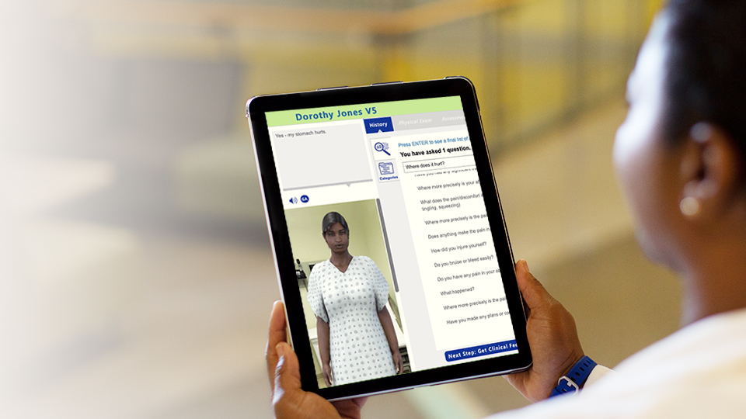
PREPARE ON-SITE THROUGH
EXPERIENTIAL LEARNING
Experiences
as diverse as the
patients we serve.
Notes:
At Chamberlain, you will experience many different virtual patient care scenarios to prepare you for clinical practice. The healthcare field is very diverse and we aim to give you as many experiences as possible so that you will be ready for whatever patient you serve.

Slide 20
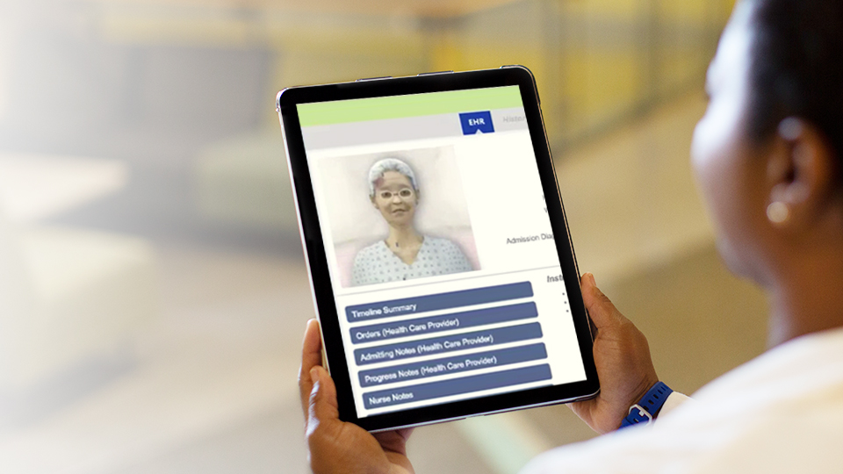
PRACTICE IT FIRST BEFORE CLINICAL
Virtual
Skills Labs
Video
Demonstrations
Live Skills
Check Off
In-Home
Lab Kits
Notes:
One important learning environment will be your virtual lab classes. You will learn and practice your health assessment and nursing skills. You will be mailed individual lab kits to complete with online instruction. There are skills check ins with your instructor to reinforce content that you have learned.

Slide 21
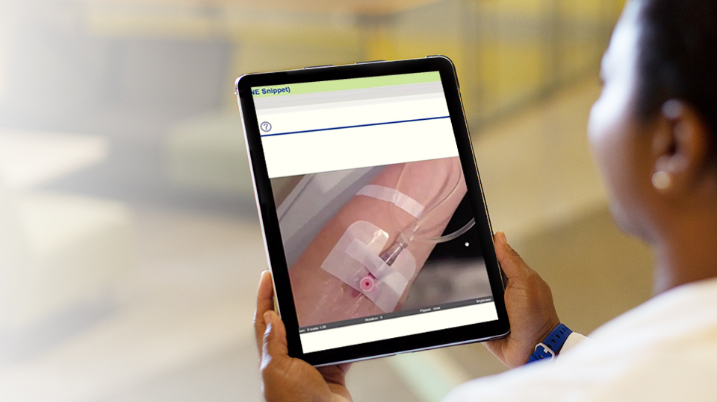
VIRTUAL SIMULATION
EXPERIENCES
Notes:
Simulation is embedded into the entire curriculum. You will have many opportunities to be in simulation, in various settings and patient scenarios. The simulated setting may be a hospital
room or a home health care environment.

Slide 22
CLINICAL IMMERSIONS WEEKS 7 & 8
NR-324 | Day 1 | Day 2 | Day 3 | Day 4 | Day 5 | Day 6 | Day 7
Week 7 Clinical Immersion | Clinical Immersion (9 hr) | Clinical Immersion (9 hr) | Clinical Immersion (9 hr) | Clinical Immersion (9 hr) |  | Clinical Immersion (9 hr) | Clinical Immersion (9 hr)
Week 8 Finals, Reflection | Clinical Immersion (9 hr) | Clinical Immersion (9 hr) |  | Final Exam |  | Reflection
Sunday: Travel
Monday-Thursday: Clinical
Friday: No clinical
Saturday-Tuesday: Clinical
Wednesday: Travel home
Notes:
Clinical experiences will occur at the end of each 8 week session that has a clinical course. Students will prepare online through virtual labs and simulations. Students will then attend live onsite clinical at our partner locations. Times and days will vary. A typical clinical experience might look like this (EXPLAIN the SLIDE):
For sessions requiring a total of 72 clinical hours
This is based of a 9 hours clinical experience (1 hour pre/post conference and an 8 hr evening shift 2 pm – 11 pm)
If a student should need to travel to clinical site and lodge nearby: Travel Sunday. Clinical M-TH. Friday NO CLINICAL. Clinical SAT-TUE. Travel home Wednesday
Pre-conference, clinical experience, post-conference

Slide 23

BACHELOR OF SCIENCE IN NURSING (BSN)
DEGREE PROGRAM ONLINE OPTION
 | SEMESTER 1 | SEMESTER 2 | SEMESTER 3
YEAR 1 | One of General Education Core Quantitative Reasoning One of General Education Core English & Communications | CHEM-120 One of General Education Core Social Sciences | One of General Education Core Quantitative Reasoning BIOS-251 One of General Education Core Humanities & Fine Arts
 | One of General Education Core English & Communications One of General Education Core Social Sciences | One of General Education Core Humanities & Fine Arts BIOS-242 | One of General Education Core Social Sciences BIOS-252 One of General Education Core Humanities & Fine Arts
year
1
year
2
YEAR 2 | BIOS-255 One of General Education Core Social Sciences One of General Education Core English & Communications | NR-103 NR-222 NR-283 | NR-224 NR-226
 | BIOS-256 One of General Education Core Humanities & Fine Arts | NR-306 NR-293 | NR-228 NR-324
YEAR 3 | BIOS-255 One of General Education Core Social Sciences One of General Education Core English & Communications | NR-103 NR-222 NR-283 | NR-224 NR-226
 | BIOS-256 One of General Education Core Humanities & Fine Arts | NR-306 NR-293 | NR-228 NR-324
year
3
Notes:
Mention a typical schedule for the first year, etc.
Students will start the program in the semester that aligns with courses needed for completion. Students with transfer credits will have a shorter time to completion. Courses are completed in a lock and step, sequenced manner.

Slide 24

ADMISSION PROCESS
Notes:
Now I would like to hand the presentation over to one of our admissions advisors to explain the admission process.

Slide 25

ADMISSION PROCESS
After application, passion statement and transcripts
received, HESI admission assessment completed.
The file goes to the admission committee
Admission committee reviews for:
Academic eligibility
2.75+ cumulative GPA
73+ HESI Admission Assessment
Clinical eligibility
Drug screen
Background check
Fingerprint check
Notes:
Explain admission process – read slide

Slide 26
ADMISSION PROCESS
1
After application, passion statement and transcripts received, HESI admission assessment completed
3
Admission committee reviews for:
Academic Eligibility
2.75+ cumulative GPA
73+ HESI Admission Assessment
Clinical Eligibility
Drug screen
Background check
Fingerprint check
2
The file goes to the Chamberlain Admission Committee

Slide 27

STUDENT
SERVICES
Notes:
INSTRUCTIONS: What Are We Going To Cover Today?
PRESENTER: (Recommended: Director of Admission)
SCRIPTING
Now we will discuss Student services

Slide 28
STUDENT SERVICES
Student Support Advisors – Academic & Financial Aid Advising
Academic:
Customized degree plan for program and course registration
Total program is 122 credit hours
(56 General Education and Sciences/66 credits of Nursing coursework)
Financial:
Do you plan to use Federal Financial Aid? Don’t know?
Complete the 2020-2021 Free Application for Federal Student Aid (FAFSA)!
And add Chamberlain School Code: 006385
We will review an Estimated Financial Plan with you based on your financial aid award information to help you plan for your remaining need balance.
Tuition = $675/credit hour
Career Services
Assist with resume review and mock interviewing
CareerCare™ is a database of job openings for students and graduates
Notes:
Student service advisor – read slide

Slide 29

CHAMBERLAIN'S NEW BSN ONLINE OPTION CREATED WITH YOU IN MIND
We are excited to help you take
the next step toward becoming
an extraordinary nurse!
Notes:
Director/Dean of Nursing
We are excited you are interested in Chamberlain's BSN Online Degree Option. This innovative program was designed with you in mind...

Slide 30
INTERESTED TO SUBMIT AN
APPLICATION & MOVE FORWARD?
Put your name and number in the Chat Box
or contact your admission representative:
Carya Holmes
carya.holmes@adtalem.edu
630.458.8153
Paula Kochan
pkochan@chamberlain.edu
630.442.1355
QUESTIONS?
Notes:
For those of you who are interested in learning more please put your name and number in the chat box or contact your admission rep – information on the slide.

Slide 31
Q&A

